Slide 1
Online Attendance Register Using Android stuido (Attend My Class)
Prabhu.R (311620104040)
Kumar.S.N (311620104302)

Slide 2
Abstract:
An online attendance register is an application that allows teachers to take attendance of the students registered in their class. It’s an excellent alternative to the hectic old registers or sheet method. It promotes paperless environments and also makes the task easier. Using the app, the students can self-track their attendance too.

Slide 3
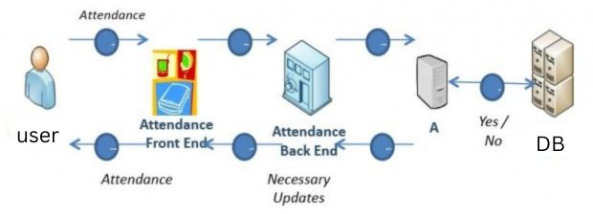
Architecture diagram

Slide 4
Modules and it's explanation
User Authentication
The User Authentication module is responsible for securely authenticating users of the online attendance register app. It ensures that only authorized individuals, such as teachers and students, can access the app's features. This module includes functionalities like user registration, login, and password reset. It utilizes encryption techniques and secure protocols to protect user credentials and prevent unauthorized access.

Slide 5
Attendance Tracking
The Attendance Tracking module is the core functionality of the online attendance register app. It allows teachers to record and manage attendance for their classes efficiently. This module includes features such as creating class schedules, adding students to classes, and marking attendance. It provides a user-friendly interface for teachers to easily navigate through different classes and mark attendance for each student.

Slide 6
Data Management
The Data Management module is responsible for storing and managing attendance data in the online attendance register app. This module utilizes a secure firebase database to store attendance records, ensuring data integrity and privacy. It also implements data synchronization mechanisms to ensure that the app operates seamlessly across multiple devices. The module provides efficient data retrieval, allowing users to access and retrieve attendance data quickly.

Slide 7
Integration with Backend Systems
The Integration with Backend Systems module enables the online attendance register app to integrate with external systems or services. This module facilitates seamless data exchange with existing backend systems, such as student information systems or learning management systems. It allows the app to fetch relevant data, such as student details or class schedules, from these systems to populate the attendance tracking functionalities.

Slide 8
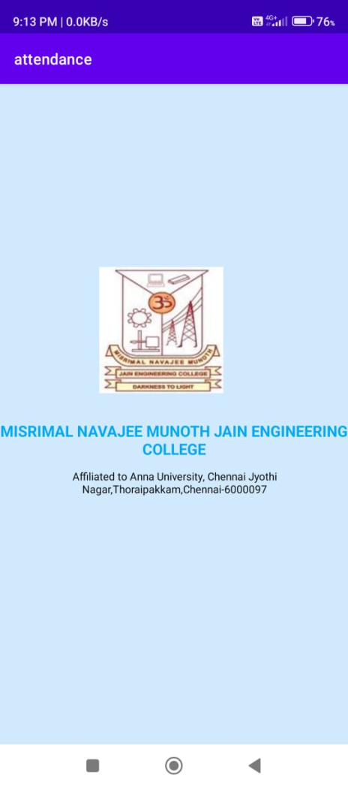
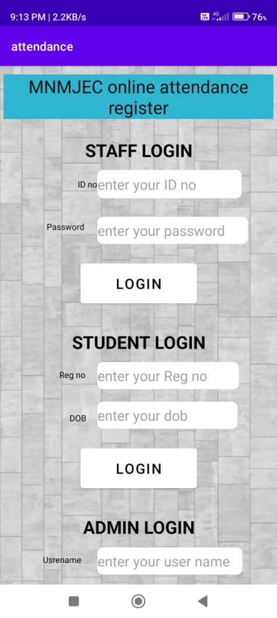
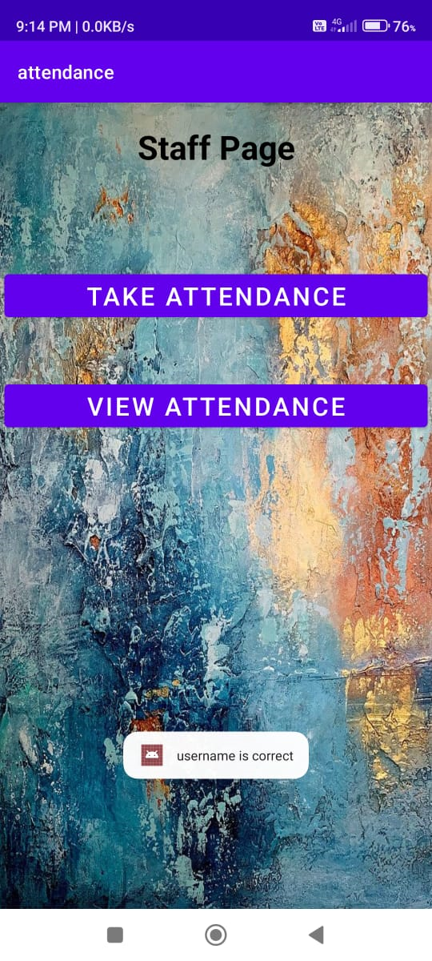
screen shots of the output

Slide 9
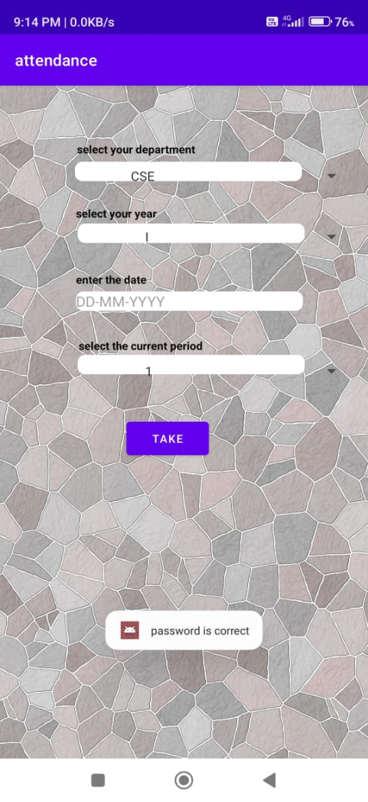
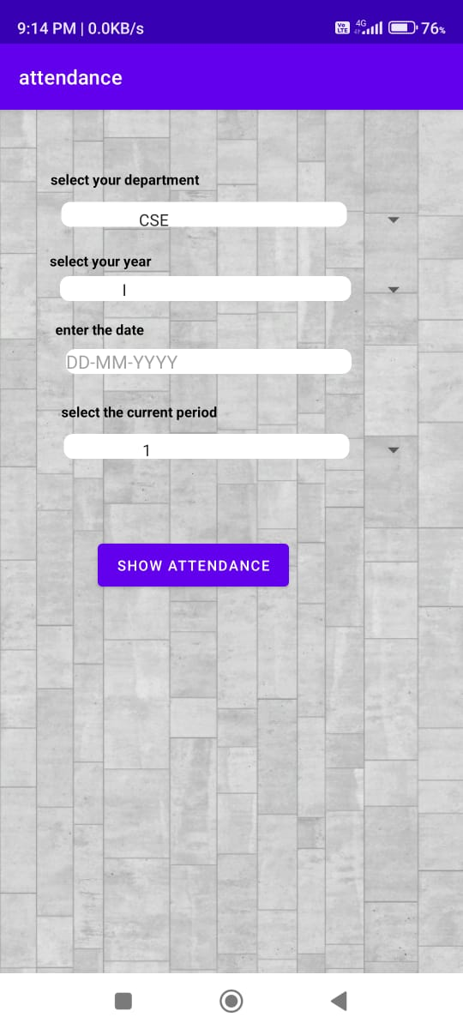
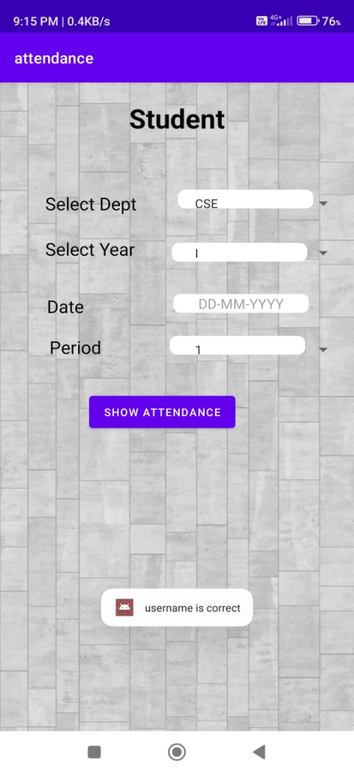

Slide 10
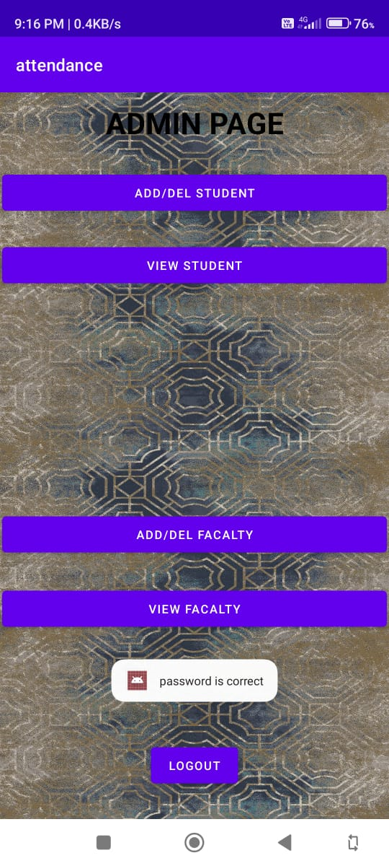
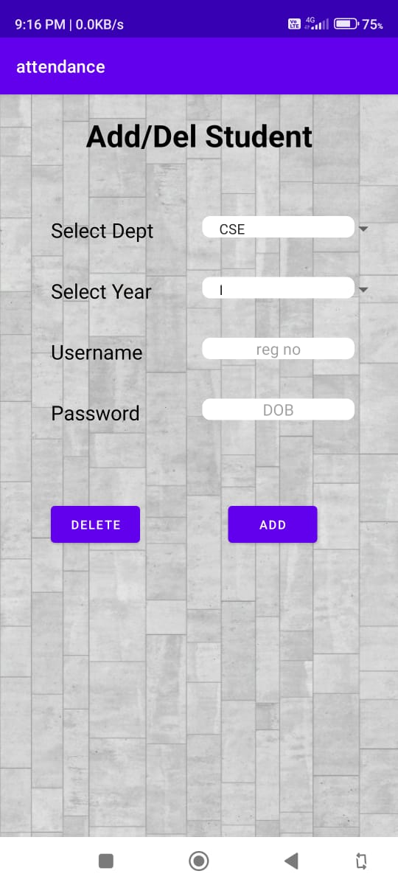
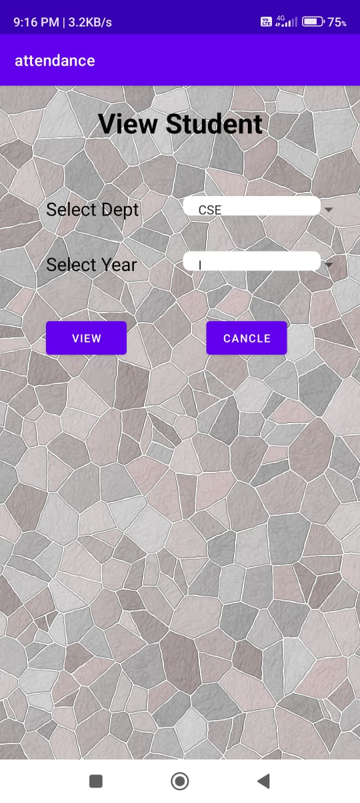

Slide 11
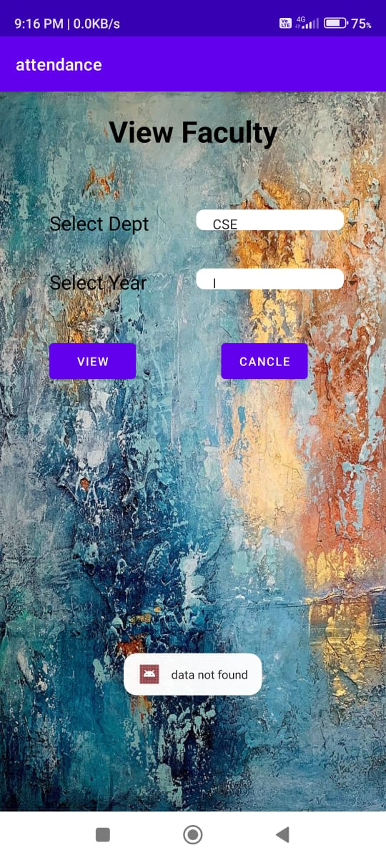


Slide 12
References
M. A. Gerosa and C. Lucena, “The Development and Application of Distance Learning Courses on the Internet RDL-Reuse Representation View project An Agent-based Framework for the Internet of Things View project,” Taylor Fr., vol. 17, no. 1, pp. 23–38, 2002, doi: 10.1080/02680510120110157.
C. Series, “Development of physics learning e-module based on local culture wisdom in Pontianak , West Kalimantan Development of physics learning e-module based on local culture wisdom in Pontianak , West Kalimantan,” 2019, doi: 10.1088/1742-6596/1381/1/012045.
T. Partovi and M. R. Razavi, “The effect of game-based learning on academic achievement motivation of elementary school students,” Learn. Motiv., vol. 68, no. August, p. 101592, 2019, doi: 10.1016/j.lmot.2019.101592.
A. Hussein and M. Hussain, “Social-media based assessment of academic programs,” Stud. Educ. Eval., vol. 62, no. June, pp. 149–157, 2019, doi: 10.1016/j.stueduc.2019.06.003.

Slide 13
THANK YOU

